Slide 1
Git & GitHub ‘Basics’ {
forbeginners.html
workshop.css
[For Beginners Workshop]
<The best tool you’ll learn />
}
Git & GitHub

Slide 2
Table Of ‘Content’ {
01
02
03
forbeginners.html
workshop.css
Generalities about Git & GitHub
< All you need to know about git & github/>
Core concepts
< All the important concepts you need to know/>
Hands-On Practice
< let the fun begin! />
}
Git & GitHub

Slide 3


01 {
[Generalities about Git & GitHub]
forbeginners.html
workshop.css
}
Git & GitHub

Slide 4
Git< /1 > {
forbeginners.html
workshop.css
< Git is a distributed version control system that tracks changes in computers files. It’s commonly used by programmers collaborating on source code during software development.>
}
GitHub< /2 > {
< GitHub is a developer platform that enables developers to create, store, manage, and share their code, it simplifies code management, foster collaboration and empowers developers around the world!>
}
Git & GitHub

Slide 5
What is the difference between Git & GitHub{
forbeginners.html
workshop.css
‘in one paragraph!’
<p> Git is a distributed version control system used for tracking code changes, while GitHub is a web-based platform that hosts Git repositories,facilitates collaboration and adds features like user management and issue tracking
</p>
}
Git & GitHub

Slide 6
Reasons to lrean ‘Git & GitHub’ {
forbeginners.html
workshop.css
01
Collaboration
02
Version Control
03
Industry Standard
04
Showcase Your Work!
}
Git & GitHub

Slide 7
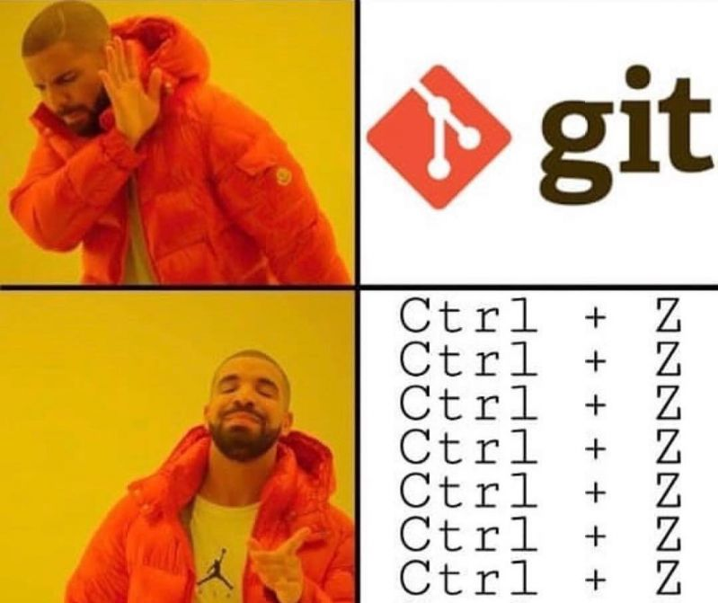
forbeginners.html
workshop.css
Git & GitHub

Slide 8

forbeginners.html
workshop.css
Git & GitHub

Slide 9
02 {
[Core concepts of working with Git & GitHub]
forbeginners.html
workshop.css
}
Git & GitHub

Slide 10


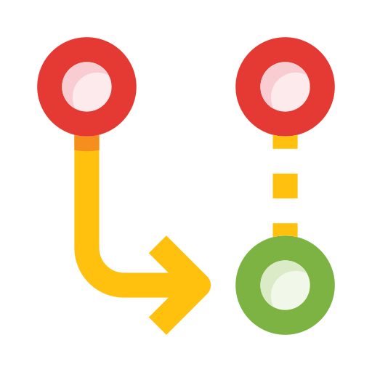

Key concepts of ‘Git & GitHub’{
forbeginners.html
workshop.css
Repositories
Branches
< Containers for your code and files.>
< Parallel versions of your code for different purposes.>
Commits
Pull Request
< Snapshots of your code at specific points in time.>
< Propose changes and collaborate with others>
}
Git & GitHub

Slide 11

From ‘Linus’ To Github {
forbeginners.html
workshop.css
< Ever wondered who the mastermind behind git was? Well it’s none other than Linus Torvalds, the same genuis who created Linux. Linus built Git out of sheer frustration with existing version control systems. />
}
Git & GitHub

Slide 12
03 {
[Hands-On Practice]
forbeginners.html
workshop.css
}
Git & GitHub

Slide 13
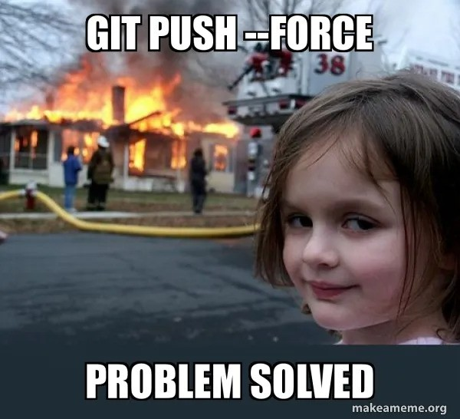
forbeginners.html
workshop.css
Git & GitHub

Slide 14
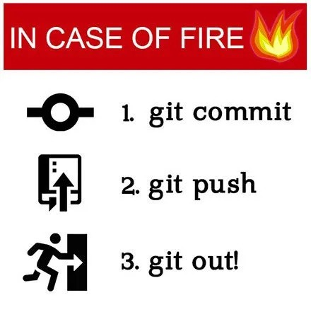
forbeginners.html
workshop.css
Git & GitHub

Slide 15
—Albert‘ Einstein’
forbeginners.html
workshop.css
< “Life is like riding a bicycle.To keep your balance, you must keep moving.” >
Git & GitHub

Slide 16
Thank { You!;
forbeginners.html
workshop.css
}
Git & GitHub

Slide 17


